Slide 1
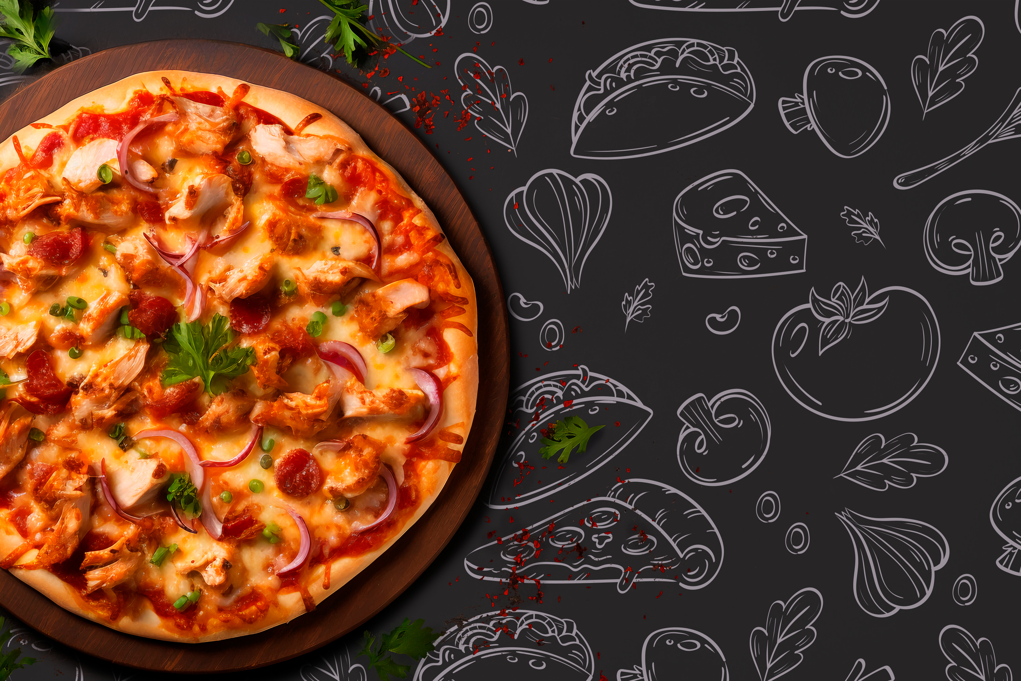
Pizza Sales Analysis Dashboard

Slide 2

Project Objectives
Analyze pizza sales performance using real business data
Build an interactive dashboard with KPIs & visuals
Identify best-selling and worst-selling pizzas
Detect sales patterns across time, size, and categories
Provide insights to improve decision-making

Slide 3
Dataset Overview
Source: Pizza Sales Data.
Key Fields: order_id, order_date, order_time,pizza_name, pizza_category, pizza_size,quantity, total_price, unit_price.
Time Dimensions: Day_of_Week, Month, Hour_of_Day, Week_Number

Slide 4
Dashboard Pages
Page 1 – Home (Sales Overview)
-KPIs (Revenue, Orders, AOV, Daily Orders)
-Orders & Revenue by Category
-Revenue by Day of Week & Hourly Sales
-Monthly Trends
Page 2 – Best/Worst Pizza Analysis
-Top & Bottom 5 Pizzas (Quantity, Orders, Revenue)
-Best & Least Sellers panel
Page 3 – Sales Breakdown
-Sales by Pizza Size
-Sales by Category
-Hourly Sales (Stacked by Category)
-Category-wise Revenue by Day of Week
-Daily Revenue trend

Slide 5
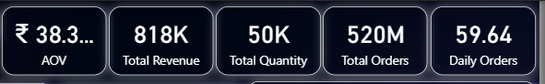
Key Metrics (KPIs)
Insights – Sales Trends
Peak Hours: 12 PM & 6 PM
Busiest Day: Friday
Monthly Sales: Stable (15K–17K/month).
Category Performance: Classic (highest revenue share).
Size Performance: Large pizzas dominate sales.
Total Revenue: ₹818K
Total Orders: 520M
Total Quantity Sold: 50K pizzas
Average Order Value: ₹38.3
Daily Orders: 60
Insights – Best & Worst Sellers
Best Sellers:
-Hawaiian Pizza
-Classic Deluxe Pizza
-Barbecue Chicken Pizza
Least Sellers:
-Brie Carre Pizza
-Spinach Pesto Pizza
-Chicken Alfredo Pizza

Slide 6
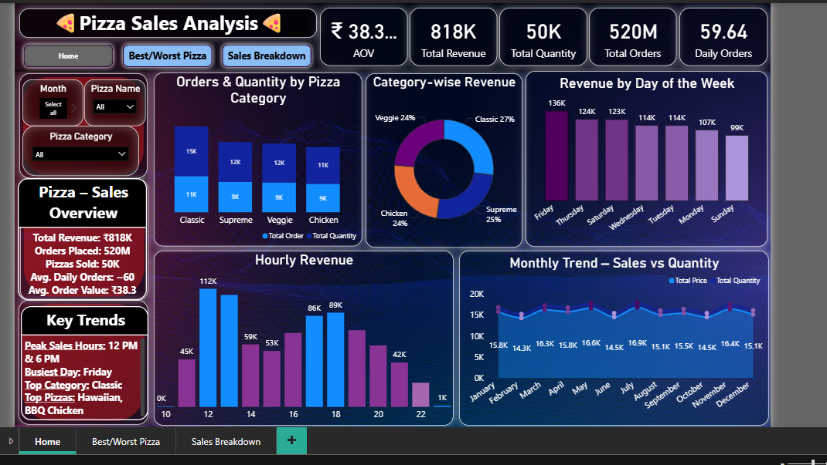
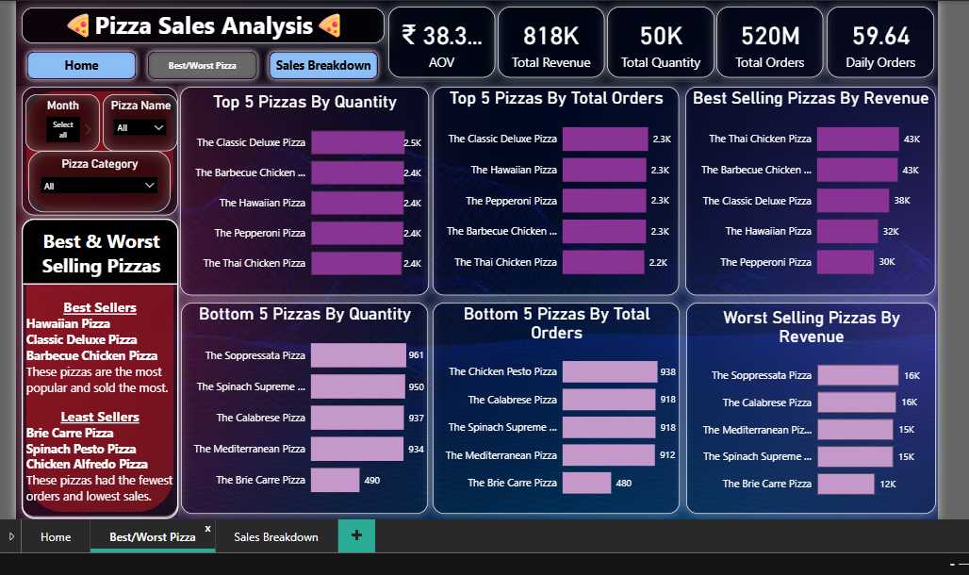
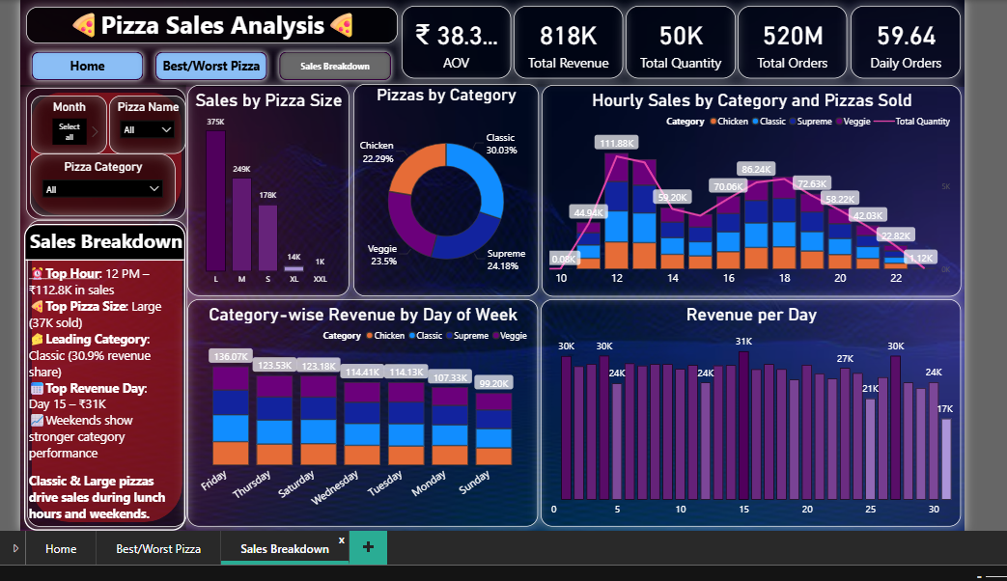

Slide 7
Business Value
Helps identify top-performing pizzas and scale production.
Pinpoints low-performing items -> improve marketing or discontinue.
Reveals time-based sales patterns -> optimize staffing & promotions.
Provides data-driven decision-making for business growth.

Slide 8
Conclusion
The dashboard provides a 360° view of pizza sales.
Classic & Large pizzas drive maximum revenue.
Fridays & weekends generate the highest sales.
Clear identification of best and worst sellers.
Supports strategic decisions in sales, marketing, and operations.

Slide 9

Thank You!!!!!!!
-Pizza is Love

